Slide 1
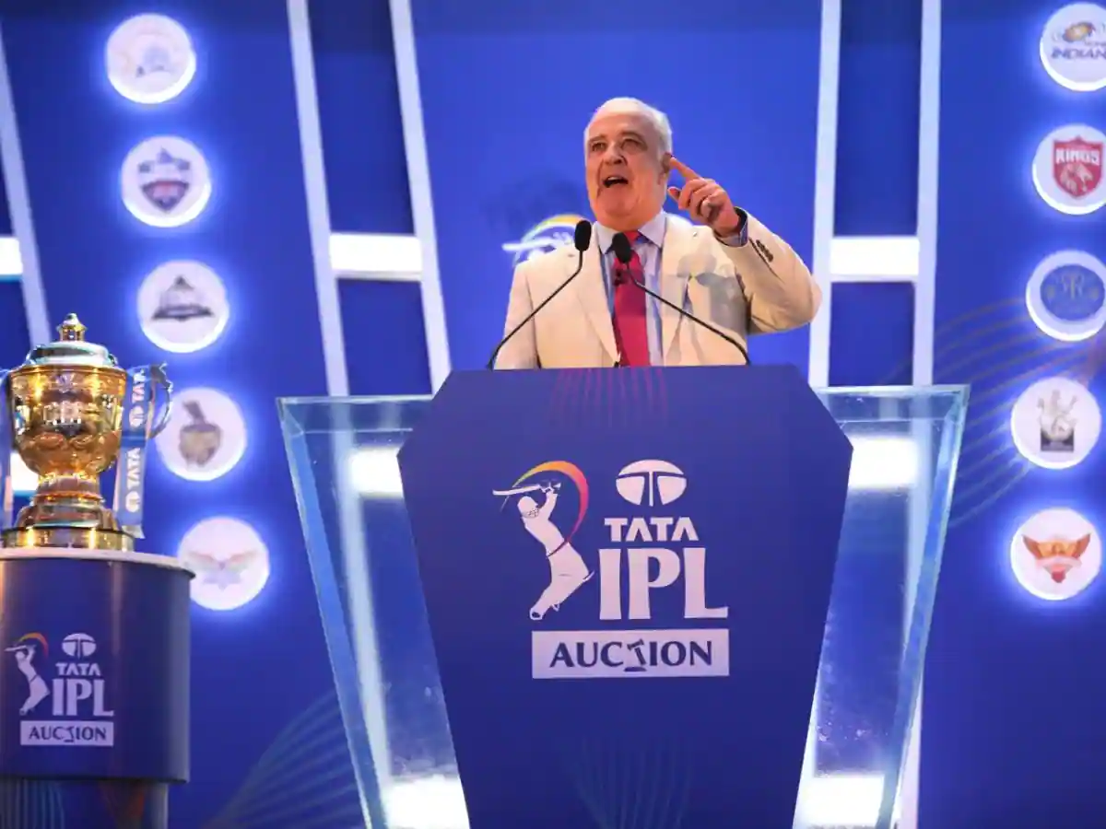
IPL AUCTION
SQL PROJECT –INTERNSHALA
NAME –RAJ BASU

Slide 2
INTRODUCTION
Annual Event: IPL auction is a yearly event where cricket franchises bid for players.
Budget Management: Franchises operate within a budget to strategically build competitive teams.
Player Categories: Players categorized as Indian/foreign, capped/uncapped.
Open Bidding: Franchises bid for players in an open process, with the highest bidder securing the player.
Retained Players: Teams can retain a set number of players before the auction.
Mega Auctions: Occasional auctions where all players are released, adding unpredictability.
Drama and Excitement: Auction day is marked by surprises, bidding wars, and global enthusiasm.
Strategic Planning: Teams plan strategically to create a balanced squad within budget constraints.
Key IPL Element: The auction significantly shapes teams for the upcoming IPL season.

Slide 3
MOTIVE
Developing auction strategy for new IPL franchise by analyzing past IPL data to create a strong and balanced squad

Slide 4
CREATE TABLE COMMAND
CREATE TABLE ipl_balls (
id INT,
inning INT,
over INT,
ball INT,
batsman VARCHAR(255),
non_striker VARCHAR(255),
bowler VARCHAR(255),
batsman_runs INT,
extra_runs INT,
total_runs INT,
is_wicket INT,
dismissal_kind VARCHAR(255),
player_dismissed VARCHAR(255),
fielder VARCHAR(255),
extras_type VARCHAR(255),
batting_team VARCHAR(255),
bowling_team VARCHAR(255)
);
CREATE TABLE ipl_matches (
id INT,
city VARCHAR(255),
match_date DATE,
player_of_match VARCHAR(255),
venue VARCHAR(255),
neutral_venue BOOLEAN,
team1 VARCHAR(255),
team2 VARCHAR(255),
toss_winner VARCHAR(255),
toss_decision VARCHAR(50),
winner VARCHAR(255),
result VARCHAR(50),
result_margin VARCHAR(50),
eliminator VARCHAR(50),
method VARCHAR(50),
umpire1 VARCHAR(255),
umpire2 VARCHAR(255)
);

Slide 5
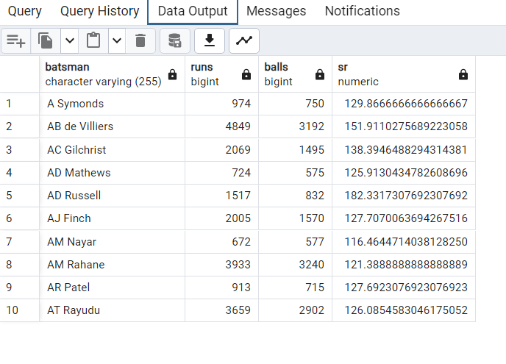
Q1. Your first priority is to get 2-3 players with high S.R who have faced at least 500 balls.And to do that you have to make a list of 10 players you want to bid in the auction so that when you try to grab them in auction you should not pay the amount greater than you have in the purse for a particular player.
SELECT
batsman ,
sum ( batsman_runs)AS runs,
COUNT(ball) AS balls,
(sum ( batsman_runs)* 100.0 / COUNT (ball)) AS sr
FROM
ipl_balls
WHERE NOT (extras_type ='wides')
GROUP BY
batsman
HAVING
COUNT (ball) >=500
ORDER BY
batsman
LIMIT
10;
SQL QUERY
OUTPUT RESULT

Slide 6
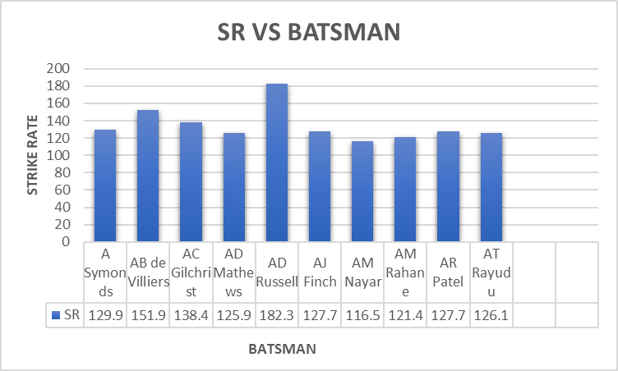
BATSMAN WITH HIGH STRIKE RATE

Slide 7
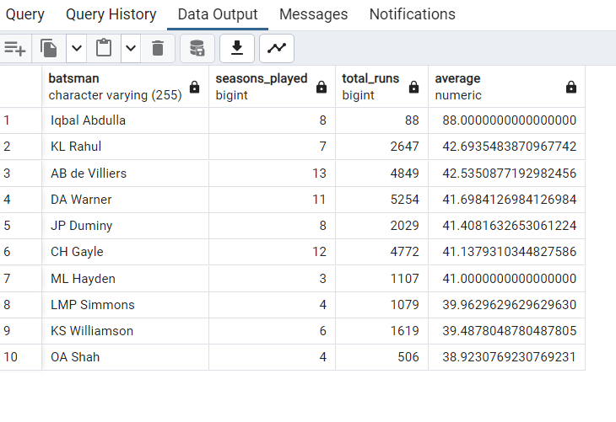


Q.2 Now you need to get 2-3 players with good Average who have played more than 2 ipl seasons. And to do that you have to make a list of 10 players you want to bid in the auction so that when you try to grab them in auction you should not pay the amount greater than you have in the purse for a particular player.
SELECT
batsman,
COUNT(DISTINCT EXTRACT(YEAR FROM m.match_date)) AS seasons_played,
SUM(batsman_runs) AS total_runs,
SUM(batsman_runs) * 1.0 / sum(is_wicket) AS average
FROM
ipl_balls
LEFT JOIN
ipl_matches AS m ON ipl_balls.id = m.id
GROUP BY
batsman
HAVING
COUNT(DISTINCT EXTRACT(YEAR FROM m.match_date)) > 2
ORDER BY
average DESC
LIMIT
10;

Slide 8
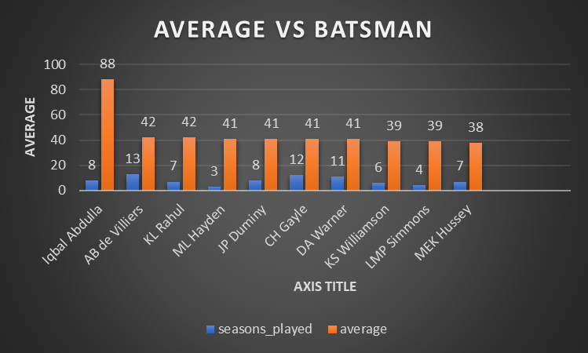
PLAYERS WITH GOOD AVERAGE RUNS

Slide 9
Q3. Now you need to get 2-3 Hard-hitting players who have scored most runs in boundaries and have played more the 2 ipl season. To do that you have to make a list of 10 players you want to bid in the auction so that when you try to grab them in auction you should not pay the amount greater than you have in the purse for a particular player.
SELECT
batsman,
COUNT(DISTINCT EXTRACT(YEAR FROM match_date)) AS seasons_played,
SUM(b.batsman_runs) AS total_runs,
SUM(CASE WHEN b.batsman_runs IN (4, 6) THEN b.batsman_runs ELSE 0 END) AS total_runs_in_boundaries,
(SUM(CASE WHEN b.batsman_runs IN (4, 6) THEN b.batsman_runs ELSE 0 END) * 100.0 / SUM(b.batsman_runs)) AS boundary_percentage
FROM
ipl_balls b
FULL JOIN
ipl_matches m ON b.id = m.id
GROUP BY
batsman
HAVING
COUNT(DISTINCT EXTRACT(YEAR FROM match_date)) > 2
ORDER BY
total_runs_in_boundaries DESC
LIMIT 10;

Slide 10

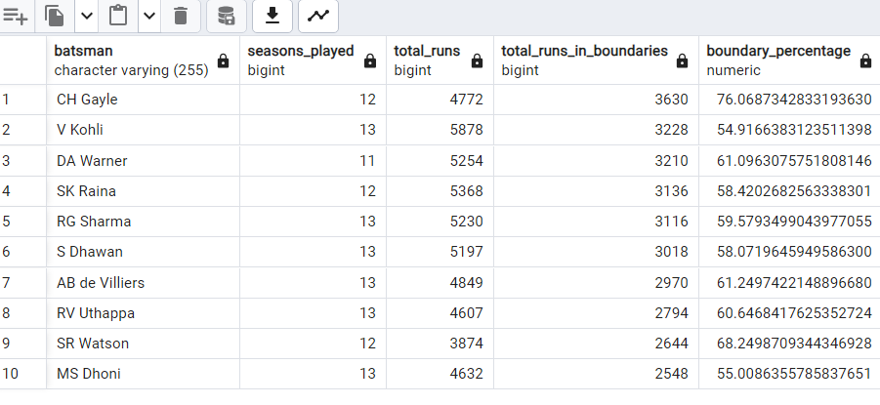

Slide 11
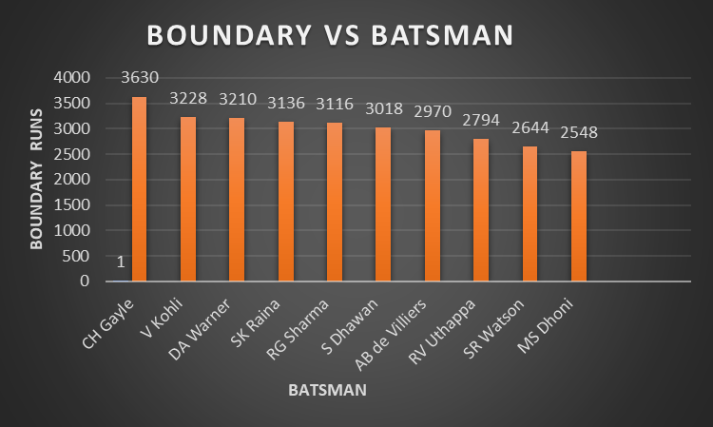
Hard-hitting players who have scored most runs in boundaries

Slide 12
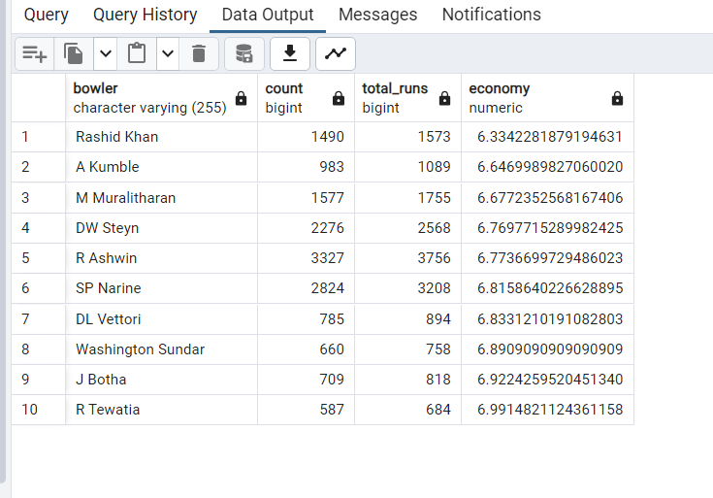
Q4 .Your first priority is to get 2-3 bowlers with good economy who have bowled at least 500 balls in IPL so far.To do that you have to make a list of 10 players you want to bid in the auction so that when you try to grab them in auction you should not pay the amount greater than you have in the purse for a particular player.
SELECT
bowler,
COUNT(ball) ,
SUM(total_runs) AS total_runs,
SUM(total_runs) / (COUNT(ball) / 6.0) AS economy
FROM
ipl_balls
GROUP BY
bowler
HAVING
COUNT(ball) > 500
ORDER BY
economy ASC
LIMIT 10;

Slide 13
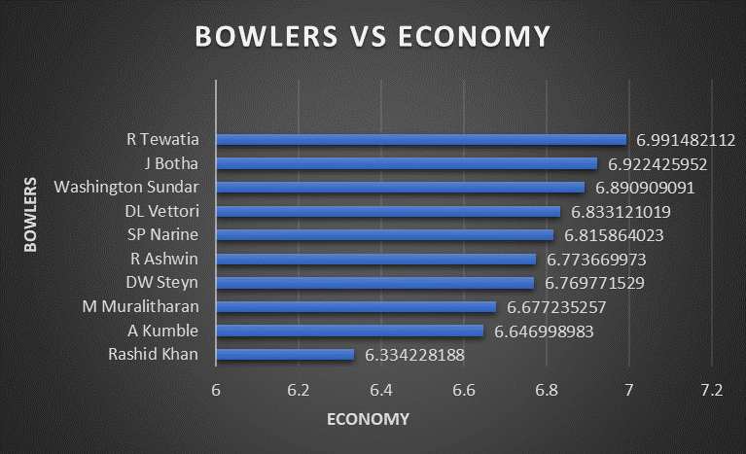
BOWLERS WITH GOOD ECONOMY

Slide 14
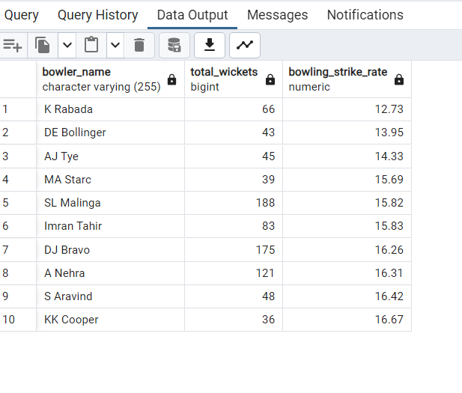

Q5. Now you need to get 2-3 bowlers with the best strike rate and who have bowled at least 500 balls in IPL so far.To do that you have to make a list of 10 players you want to bid in the auction so that when you try to grab them in auction you should not pay the amount greater than you have in the purse for a particular player.
SELECT
bowler AS bowler_name,
sum(is_wicket) as total_wickets,
ROUND(CAST(COUNT(ball) as decimal) / SUM(is_wicket) * 1.0, 2) AS bowling_strike_rate
FROM
ipl_balls
GROUP BY
bowler
HAVING
COUNT(ball) >= 500
ORDER BY
bowling_strike_rate ASC
LIMIT 10;

Slide 15
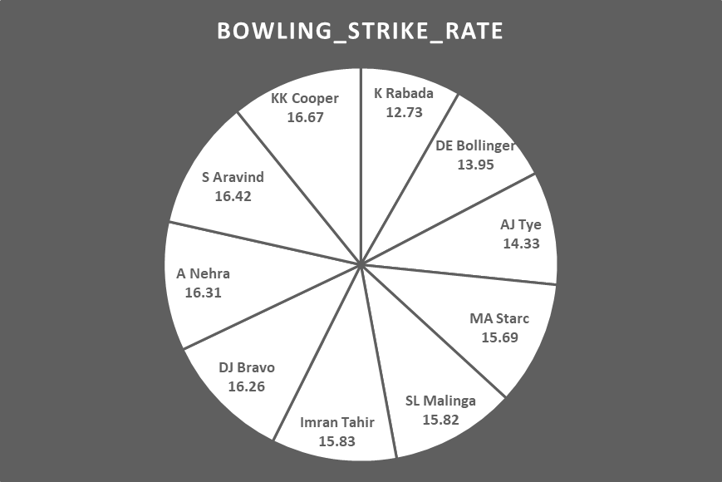
BOWLERS WITH BEST STRIKE RATE

Slide 16
Q6.Now you need to get 2-3 All_rounders with the best batting as well as bowling strike rate and who have faced at least 500 balls in IPL so far and have bowled minimum 300 balls.To do that you have to make a list of 10 players you want to bid in the auction so that when you try to grab them in auction you should not pay the amount greater than you have in the purse for a particular player.
SELECT
a.player,
a.total_balls_faced,
a.total_runs_scored,
a.batting_strike_rate,
b.total_deliveries,
b.bowling_strike_rate,
b.total_runs_conceded,
b.total_wickets_taken
FROM (
SELECT
batsman AS player,
COUNT(ball) AS total_balls_faced,
SUM(batsman_runs) AS total_runs_scored,
ROUND(SUM(batsman_runs) * 100.0 / COUNT(ball), 2) AS batting_strike_rate
FROM
ipl_balls
GROUP BY
batsman
HAVING
COUNT(ball) >= 500
) AS a
JOIN (
SELECT
bowler AS player,
COUNT(ball) AS total_deliveries,
ROUND(CAST(COUNT(ball) AS DECIMAL) / SUM(is_wicket) * 1.0, 2) AS bowling_strike_rate,
SUM(total_runs) AS total_runs_conceded,
SUM(is_wicket) AS total_wickets_taken
FROM
ipl_balls
GROUP BY
bowler
HAVING
COUNT(ball) > 300
) AS b ON a.player = b.player
ORDER BY
a.batting_strike_rate DESC
LIMIT 10;

Slide 17
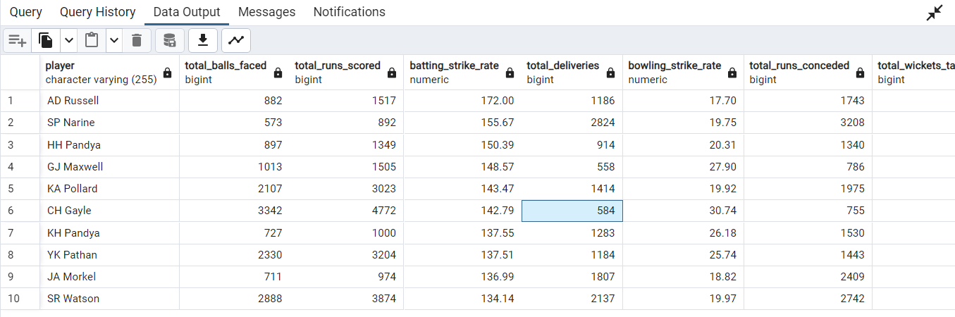

Slide 18
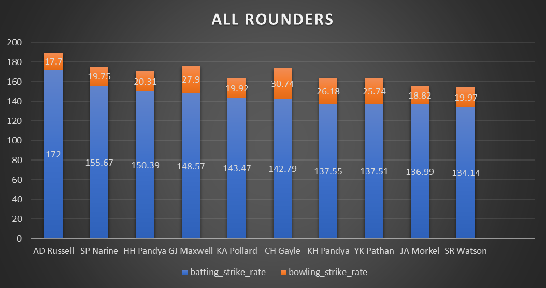
ALL ROUNDERS WITH BEST BATTING AND BOWLING STRIKE RATE

Slide 19
WICKETKEEPER CRITERIA
Criteria wicketkeepers in IPL matches, considering those who have played for at least three seasons, and have been involved in dismissals such as 'stumped' or 'caught.' It also includes wicketkeepers who have scored runs through boundaries (4, 6) or faced more than 500 balls, presenting the top 10 based on the total runs scored in boundaries, while also providing information on total runs, boundary percentage, wickets taken, and total balls faced.

Slide 20
Additional Questions for Final Assessment
1. Get the count of cities that have hosted an IPL match
SELECT
city,
COUNT(DISTINCT id) AS matches_hosted
FROM
ipl_matches
GROUP BY
city;

Slide 21
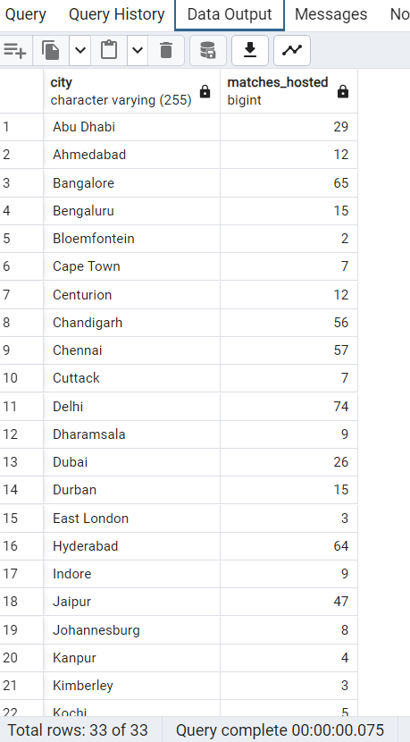
OUTPUT RESULTS

Slide 22
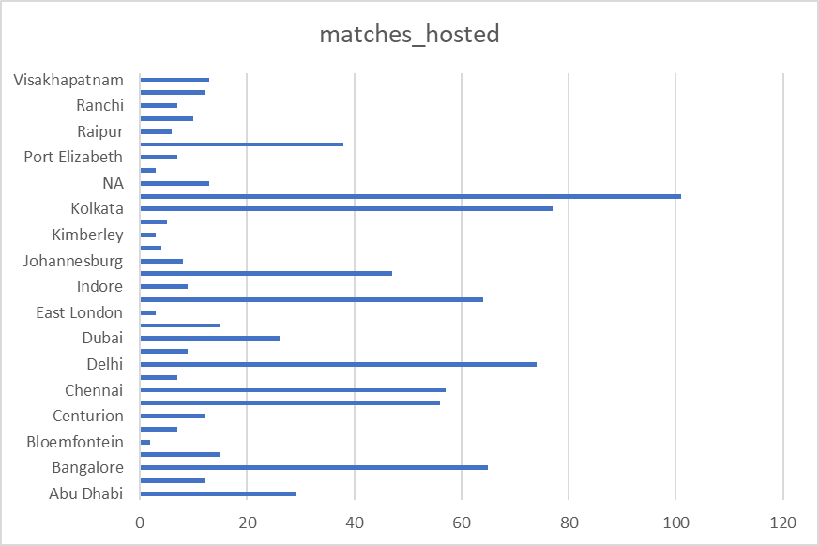
count of cities

Slide 23
02.Create table deliveries_v02 with all the columns of the table ‘deliveries’ and an additional
column ball_result containing values boundary, dot or other depending on the total_run
(boundary for >= 4, dot for 0 and other for any other number)
(Hint 1 : CASE WHEN statement is used to get condition based results)
(Hint 2: To convert the output data of the select statement into a table, you can use a
subquery. Create table table_name as [entire select statement]
CREATE TABLE deliveries_v02 AS
SELECT
id,
inning,
over,
ball,
batsman,
non_striker,
bowler,
batsman_runs,
extra_runs,
total_runs,
is_wicket,
dismissal_kind,
player_dismissed,
fielder,
extras_type,
batting_team,
bowling_team,
CASE
WHEN total_runs = 4 THEN 'boundary'
WHEN total_runs = 0 THEN 'dot'
ELSE 'other'
END AS ball_result
FROM
ipl_balls;

Slide 24
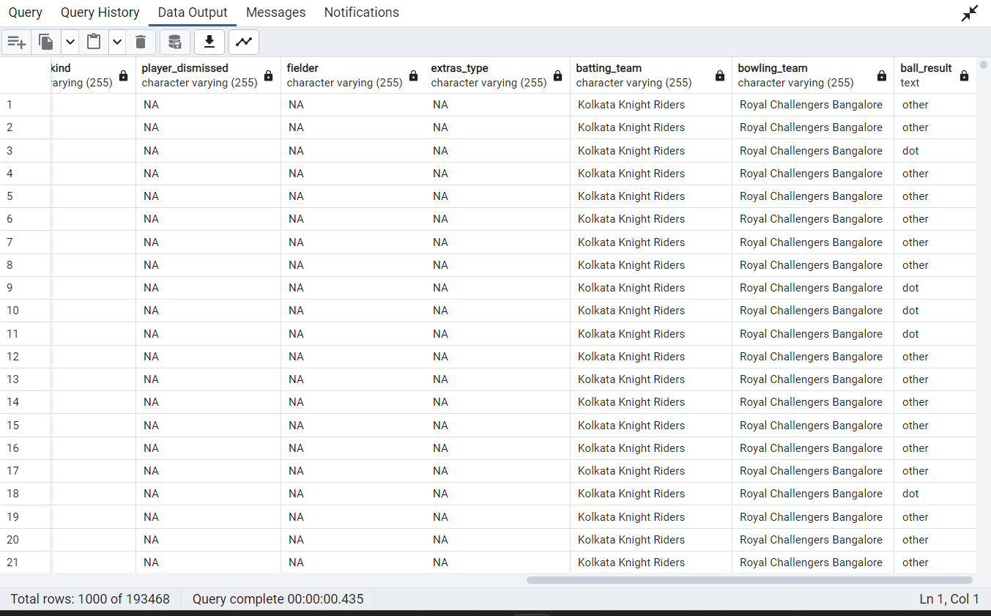
OUTPUT RESULT

Slide 25
03.Write a query to fetch the total number of boundaries and dot balls from the deliveries_v02 table.
SELECT
ball_result,
COUNT(*) AS count
FROM
deliveries_v02
WHERE
ball_result IN ('boundary', 'dot')
GROUP BY
ball_result;

Slide 26
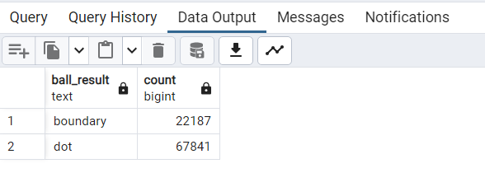
OUTPUT RESULT

Slide 27
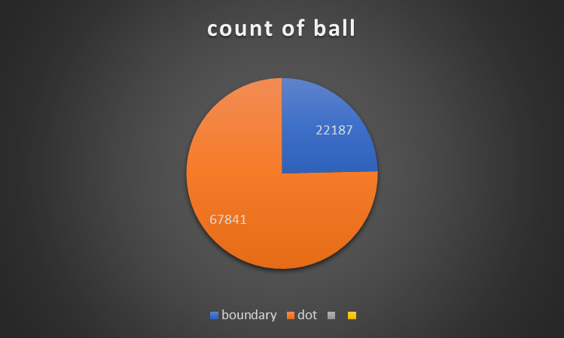
Total number of boundaries and dot balls

Slide 28
04.Write a query to fetch the total number of boundaries scored by each team from the
deliveries_v02 table and order it in descending order of the number of boundaries
scored.
SELECT
batting_team,
COUNT(*) AS total_boundaries
FROM
deliveries_v02
WHERE
ball_result = 'boundary'
GROUP BY
batting_team
ORDER BY
total_boundaries DESC;

Slide 29
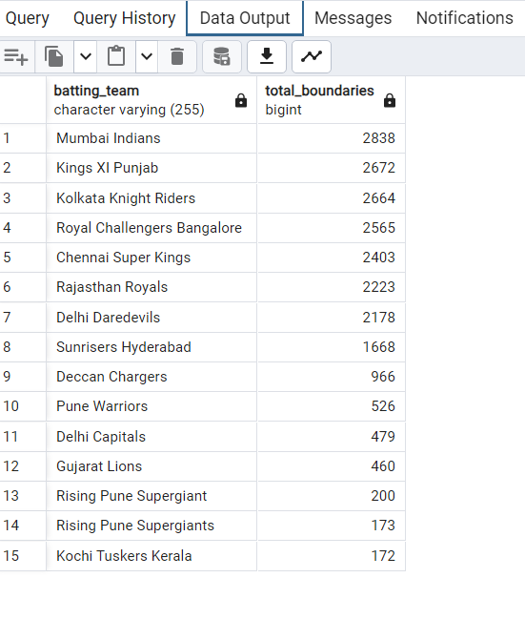
OUTPUT RESULT

Slide 30
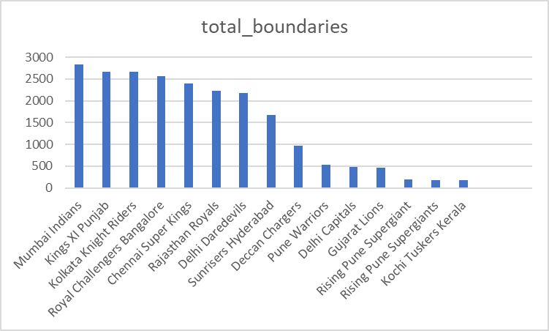
Total number of boundaries scored by each team

Slide 31
05.Write a query to fetch the total number of dot balls bowled by each team and order it in descending order of the total number of dot balls bowled.
SELECT
bowling_team,
COUNT(*) AS total_dot_balls
FROM
deliveries_v02
WHERE
ball_result = 'dot'
GROUP BY
bowling_team
ORDER BY
total_dot_balls DESC;

Slide 32
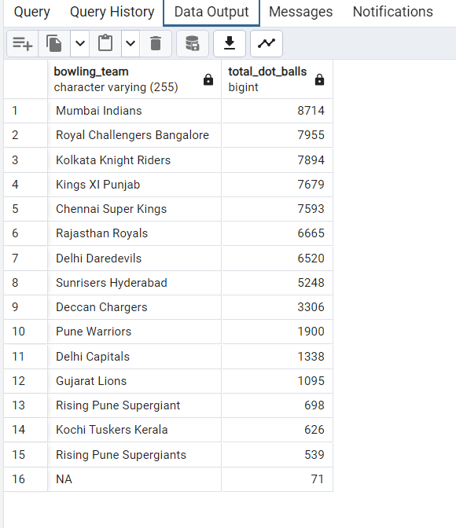
OUTPUT RESULT

Slide 33
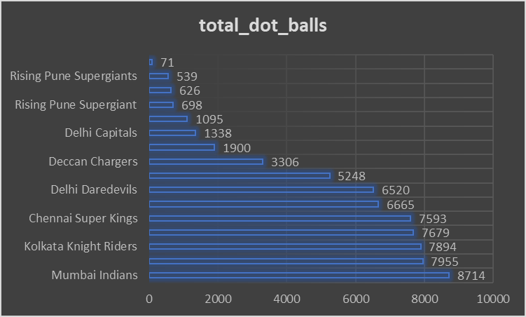
Total number of dot balls bowled by each team

Slide 34
06.Write a query to fetch the total number of dismissals by dismissal kinds where dismissal kind is not NA
SELECT
dismissal_kind,
COUNT(*) AS total_dismissals
FROM
deliveries_v02
WHERE
dismissal_kind IS NOT NULL
AND dismissal_kind <> 'NA'
GROUP BY
dismissal_kind;

Slide 35
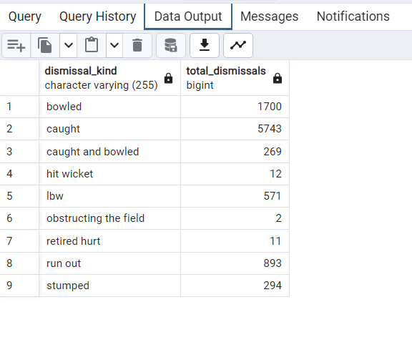
OUTPUT RESULT

Slide 36
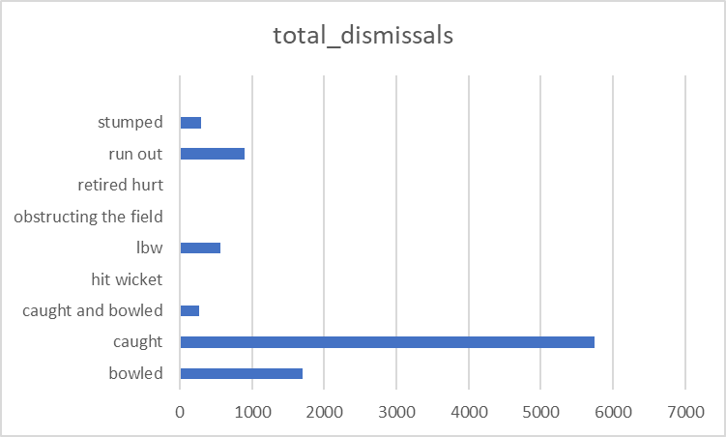
Fetch the total number of dismissals

Slide 37
07.Write a query to get the top 5 bowlers who conceded maximum extra runs from the deliveries table
SELECT
bowler,
SUM(extra_runs) AS total_extra_runs
FROM
ipl_balls
GROUP BY
bowler
ORDER BY
total_extra_runs DESC
LIMIT 5;

Slide 38
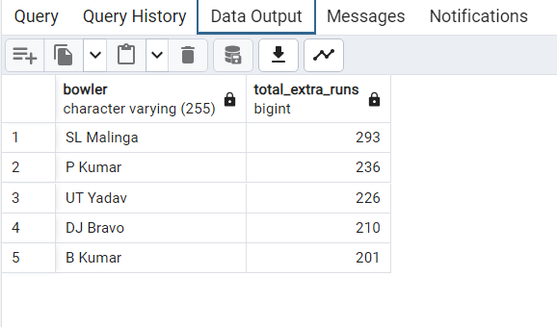
OUTPUT RESULT

Slide 39
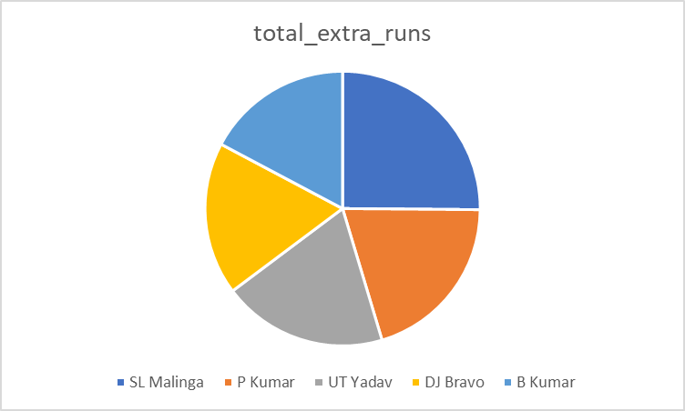
Top 5 bowlers who conceded maximum extra runs from the deliveries table

Slide 40
08.Write a query to create a table named deliveries_v03 with all the columns of deliveries_v02 table and two additional column (named venue and match_date) of venue and date from table matches
CREATE TABLE deliveries_v03 AS
SELECT
a.*,
b.venue,
b."match_date" AS match_date
FROM
deliveries_v02 AS a
LEFT JOIN
"ipl_matches" AS b ON a.id = b.id;
SELECT * FROM deliveries_v03;

Slide 41
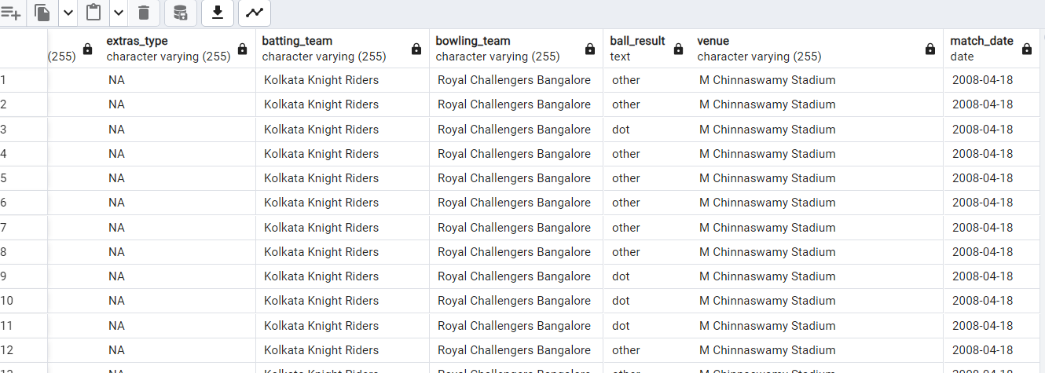
OUTPUT RESULT

Slide 42
09.Write a query to fetch the total runs scored for each venue and order it in the descending order of total runs scored.
SELECT
venue,
SUM(total_runs) AS total_runs_scored
FROM
deliveries_v03
GROUP BY
venue
ORDER BY
total_runs_scored DESC;

Slide 43
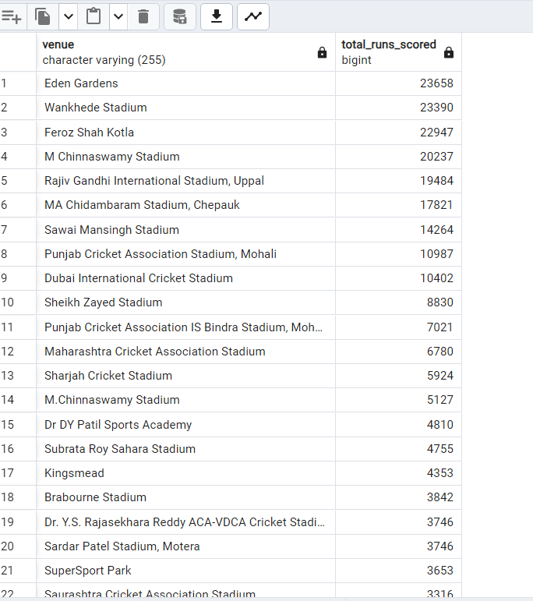
OUTPUT RESULT

Slide 44
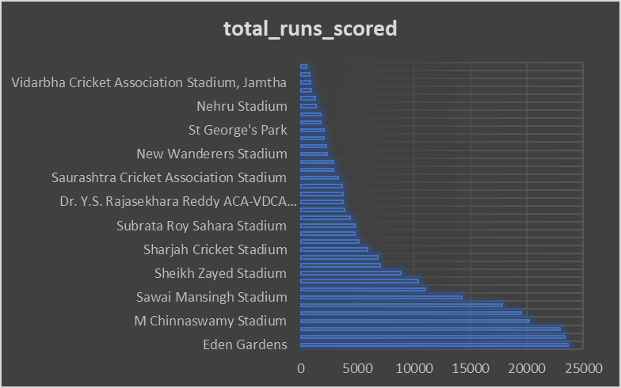
Total runs scored for each venue

Slide 45
10.Write a query to fetch the year-wise total runs scored at Eden Gardens and order it in the
descending order of total runs scored.
SELECT
EXTRACT(YEAR FROM "match_date") AS year,
SUM(total_runs) AS total_runs_scored
FROM
deliveries_v03
WHERE
venue = 'Eden Gardens'
GROUP BY
year
ORDER BY
total_runs_scored DESC;

Slide 46
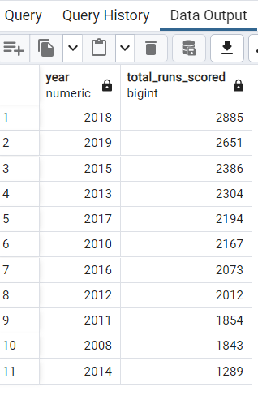
OUTPUT RESULT

Slide 47
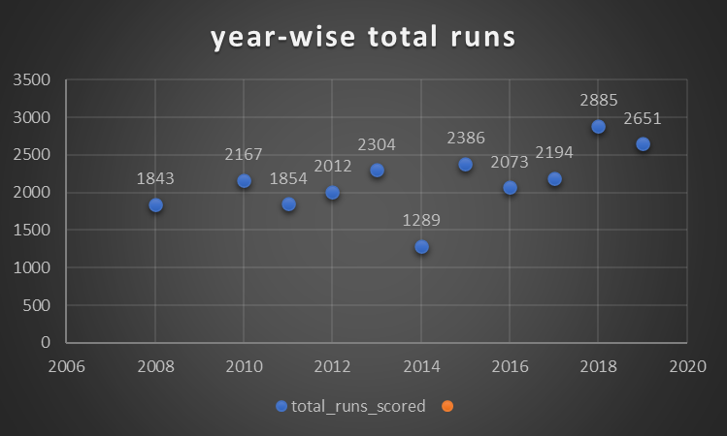
fetch the year-wise total runs scored at Eden Gardens

Slide 48
CONCLUSION
In conclusion, the IPL project analysis provides valuable insights into team performance, player dynamics, and financial strategies. The auction emerges as a pivotal event shaping the competitive landscape. The data-driven exploration highlights key players, successful strategies, and economic dimensions, offering a comprehensive view of the league's dynamics. Overall, the analysis contributes to a deeper understanding of the Indian Premier League, appealing to cricket enthusiasts, strategic planners, economists, and sports management professionals alike.

